Slide 1
Employee Data Analysis using Excel
STUDENT NAME : MOBINA S
REGISTER NO : 312216791 , D70E488685E88CD91354A90280243CFB
DEPARTMENT : B.COM ACCOUNTING AND FINANCE
COLLEGE : SHRI KRISHNASWAMY COLLEGE FOR WOMEN

Slide 2
PROJECT TITLE
Employee Performance Analysis using Excel

Slide 3


AGENDA
Problem Statement
Project Overview
End Users
Our Solution and Proposition
Dataset Description
Modelling Approach
Results and Discussion
Conclusion

Slide 4

PROBLEM STATEMENT
The main reason for employee performance analysis is to
For increment to employee
Tracking the performance of the employee
Motivate employee by appreciation i.e, promotion, increment etc..
For tracking the company’s growth

Slide 5

PROJECT OVERVIEW
Employee performance analysis is the systematic evaluation of an employee’s work output, skills, and behavior.
It involves assessing their achievements, strengths, and areas for improvement to ensure alignment with organizational goals.
This process helps in making informed decisions about development, promotions, and resource allocation.
In order to find the trends and pattern of different categories of employee like high , medium , low.

Slide 6

WHO ARE THE END USERS?
Manager and Supervisor
Human Resources
Employer
Employee
Team Leader

Slide 7

OUR SOLUTION AND ITS VALUE PROPOSITION
TECHNIQUE :
Highlights : To highlights the important cell like performance level , current employee rating , employee type status.
Conditional Formatting : It helps you quickly identify important information or trends . Ex: To given condition to the empty cell
Filter : To remove the nil value in the excel , we use filter
Formula : To track the performance level of employee in the excel , using IFS and SWITCH formula
Pivot Table : Pivot tables in Excel allow you to quickly summarize and analyze large datasets by organizing data into a concise, interactive format.
Graph : Charts in Excel visually represent data, making it easier to understand trends, patterns, and comparisons at a glance.

Slide 8
Dataset Description
Employee Dataset :
Employee Performance Dataset was downloaded from the Kaggle website, by searching .
Features :
Totally 26 features , in that 9 features has been highlighted using highlighter
Data Type :
Numeric Value : Employee Rating , Employee ID
Text : First Name , Last Name , Employee Type , Performance Level , Gender Code.

Slide 9

THE "WOW" IN OUR SOLUTION
PERFORMANCE LEVEL USING FORMULA :
=IFS(Z8>=5,"Very High",Z8>=4,"High",Z8>=3,"Medium",TRUE,"Low")
=SWITCH(Z9,0,"bad",1,"ok",2,"below average",3,"good",4,"very good",5,"excellent")
3/21/2024 Annual Review
9

Slide 10
Data Collection
Features Collection
Data Clearing
Performance Level
Summary
Visualization
MODELLING
10

Slide 11
MODELLING
Data Collection
The first step in the employee performance analysis is collect the dataset.
The employee dataset has been downloaded from the Kaggle website.
By searching employee performance dataset.
Features Collection
Emp ID , FirstName , Last Name , StartDate , Exit Date , Title Supervisor , AD Email , Employee Classification Type , Performance Score , Current Employee Rating , Performance Level (ifs) , Performance Level (switch) are the some of the features in the employee dataset analysis .
In which we highlight some of the cell like name, business unit etc..
11

Slide 12
MODELING
Data Clearing
Click on the Conditional Formatting to highlight the exit date data type as it was a nil value.
Choose Highlights Formatting Cells and choose More Rules.
Click cell value and choose BLANK and click OK.
Choose FILTER from the sort and filter to clear the exit date.
Performance Level
To create a performance level column in the cell AA1 , AB1.
In order to see the performance as high , very high , and low.
Going to use 2 formula such as IFS , SWITCH.
Formulas : =IFS(Z8>=5,"Very High",Z8>=4,"High",Z8>=3,"Medium",TRUE,"Low")
Formulas : =SWITCH(Z9,0,"bad",1,"ok",2,"below average",3,"good",4,"very good",5,"excellent")

Slide 13
MODELING
Summary
A PivotTable in Excel summarizes and analyzes large datasets by allowing users to dynamically organize, filter, and aggregate data.
Enable pivot table for the insert tab to , create a pivot table in the new worksheet.
Place data in the following
* ROWS : Business Unit
* COLUMN : Performance Level
* FILTER : Gender
* COUNT : Name

Slide 14
MODELING
Visualization
Charts in Excel visually represent data to make patterns and trends easier to understand. Users can choose from various chart types, such as bar, line, and pie, to effectively communicate different aspects of their data.
Select the content in the pivot table to provide the input to the chart.
Click insert tab to choose chart , The Excel automatically suggest the chart based one our content.
Once the chart is displayed enable Trend Lines , Axes , Chart Title , Legend.

Slide 15
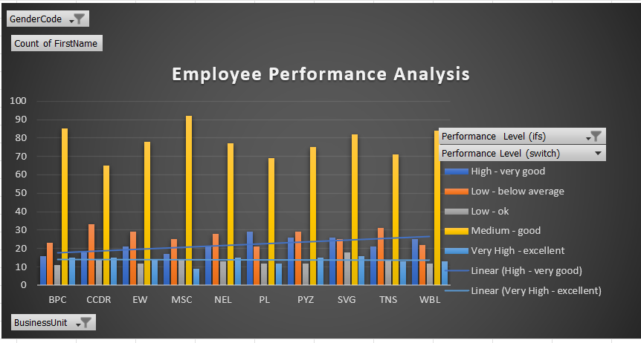
RESULTS
15

Slide 16
CONCLUSION
On this above Employee performance analysis I concluded that The MSC department contribution is higher. The employee’s contribution to the organization level is good , the company can made better strategies to make employee from good to excellent.

